Slide 1
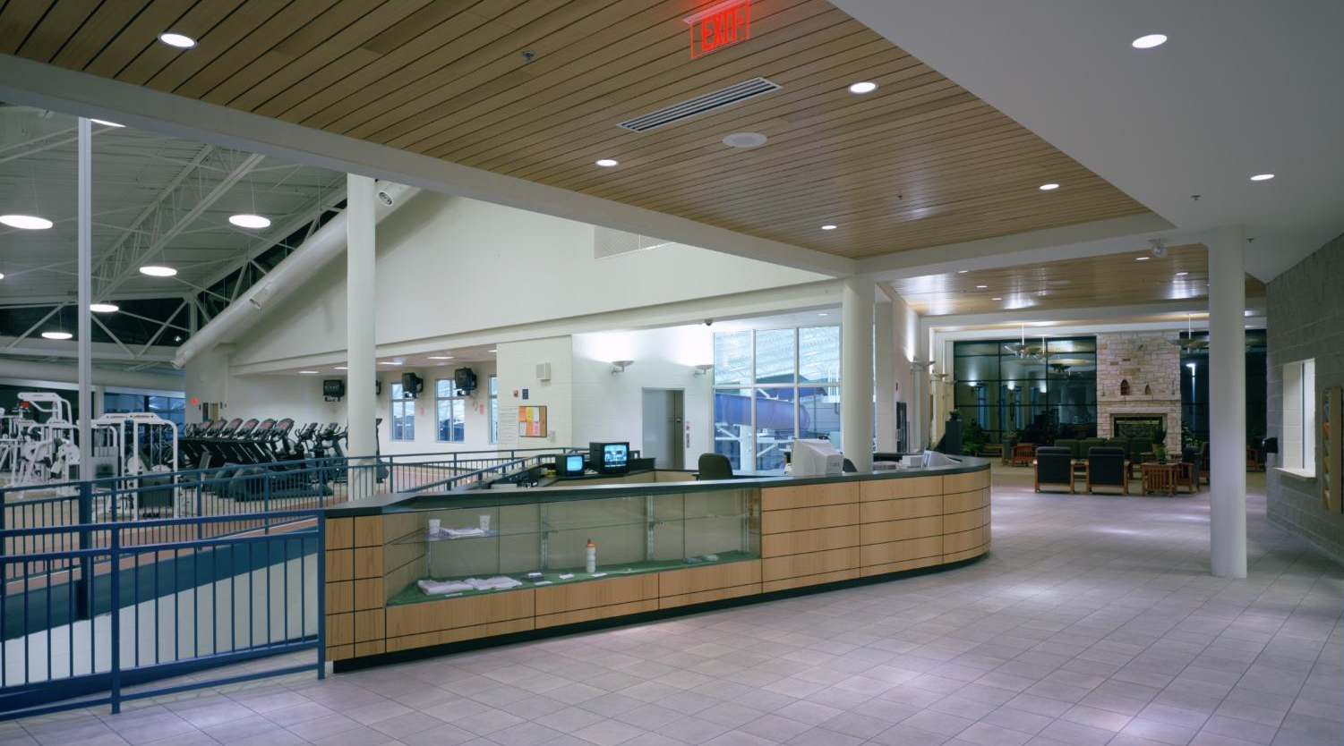


The Centre - Natatorium Planning Study: Facility Needs & Future Options

Slide 2
Project Overview: City of Rolla Natatorium Study
Natatorium Planning Study – Executive Summary
Why this study exists
  Aging natatorium
  Maintenance / operational challenges
  Community demand shifts
The 3–4 scenarios being considered
  Full aquatics
  Reduced aquatics + dry space
  Reduced aquatics + track
  All dry / no aquatics

Slide 3
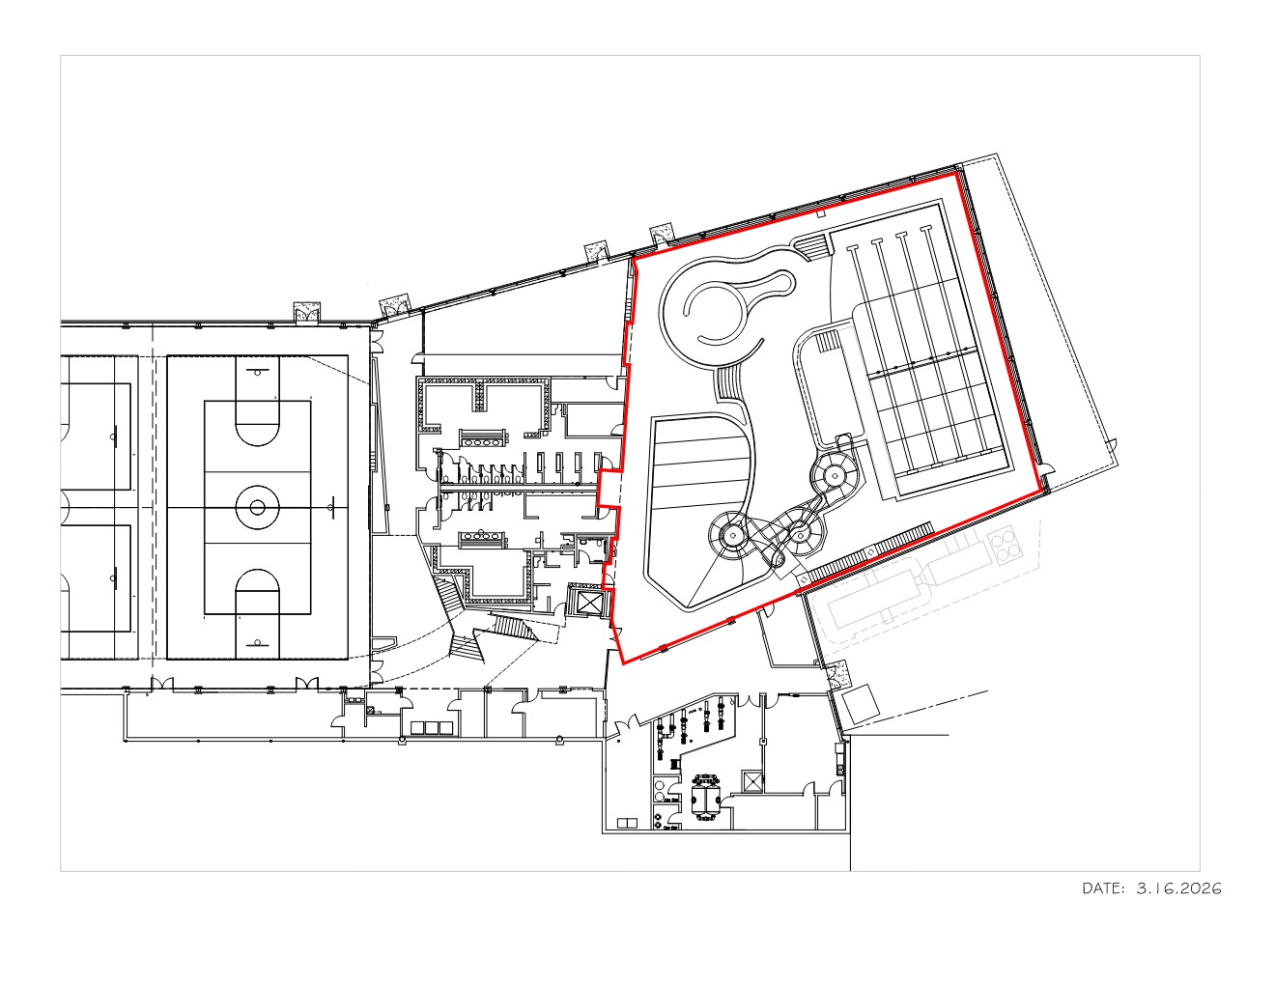
Existing Natatorium: Current Lower-Level Layout

Slide 4
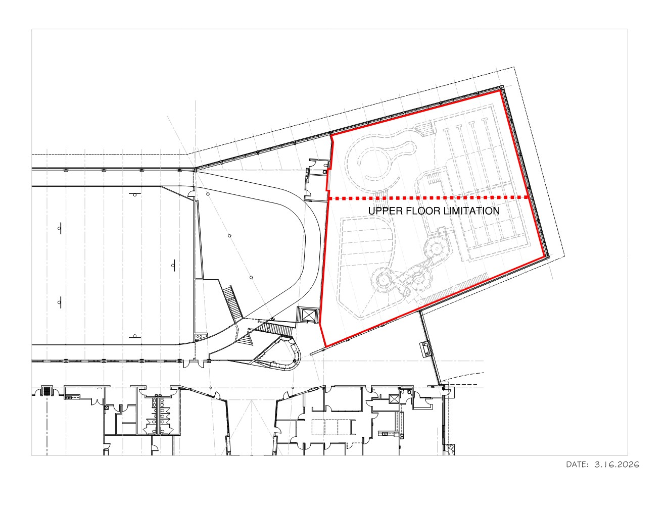
SENARIO A – FULL AQUATICS RENOVATION
Existing Natatorium: Existing Facility Constraints & Structural Limitations

Slide 5
SENARIO A – FULL AQUATICS RENOVATION
Includes:
Renovated indoor pool environment
Family and recreational aquatics
Lap swimming and swim programming
Zero‑depth or shallow water play areas
Aquatic features such as floatables or WIBIT‑style elements
Wet multipurpose space for lessons, therapy, and fitness
Supporting amenities (locker rooms, deck areas, spectator viewing)
Potential wellness features such as sauna
Focus:
Maintains a strong aquatic identity and supports traditional swim programs and family use.

Slide 6
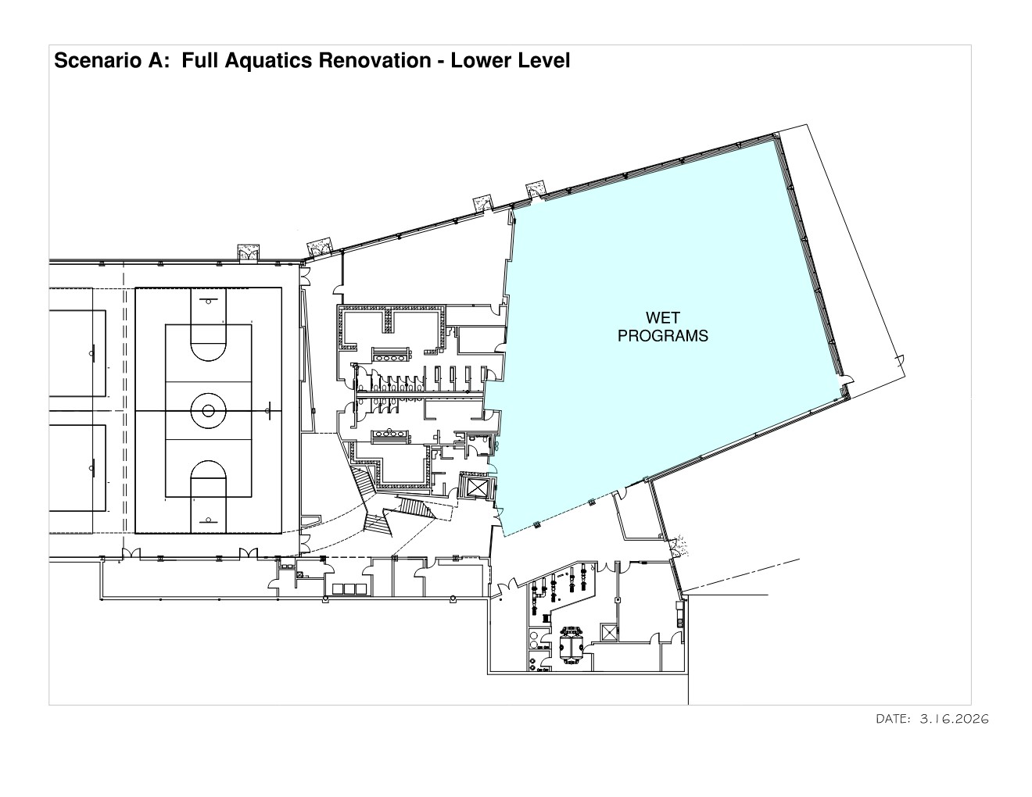

Slide 7
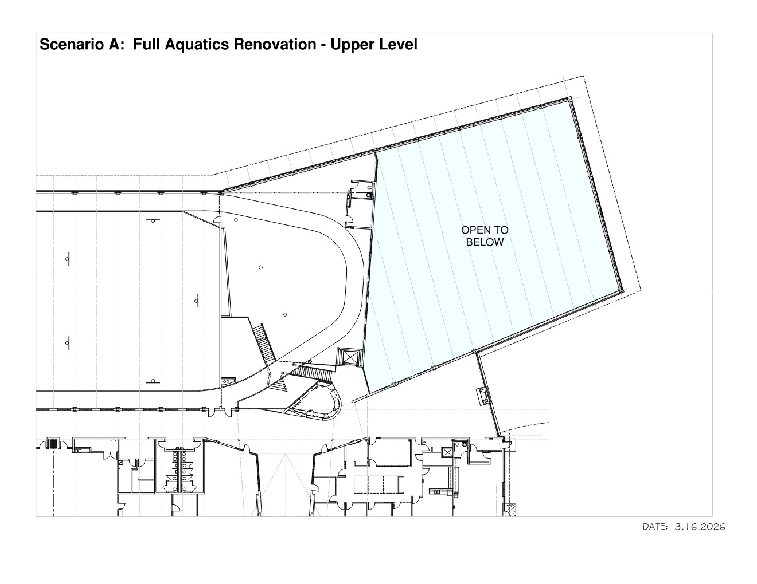

Slide 8
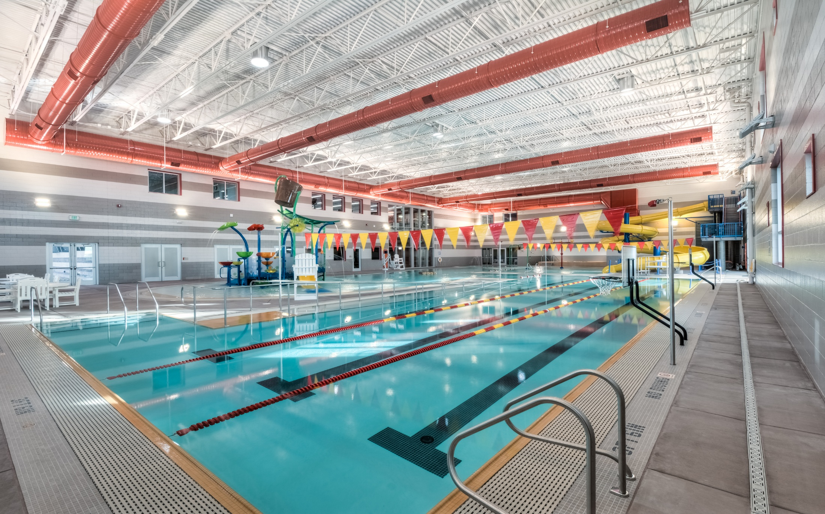
Family-Oriented Aquatics Programming Concept

Slide 9
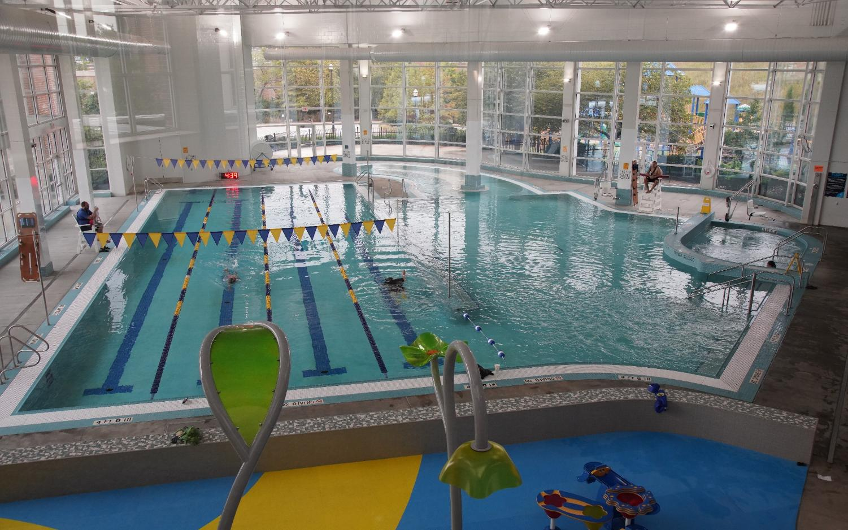
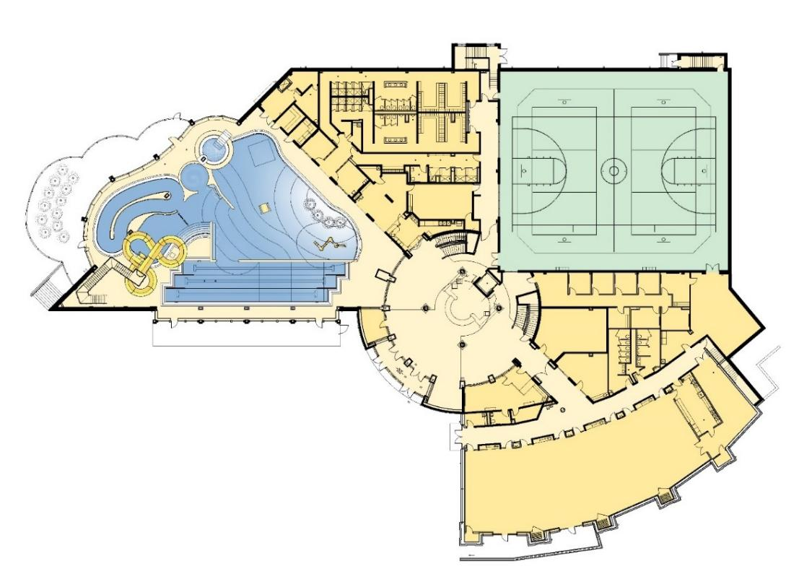
Comparable Indoor Aquatic Facilities (Precedent Examples)
Richmond Heights Community Center
Updated Replacement Pool

Slide 10
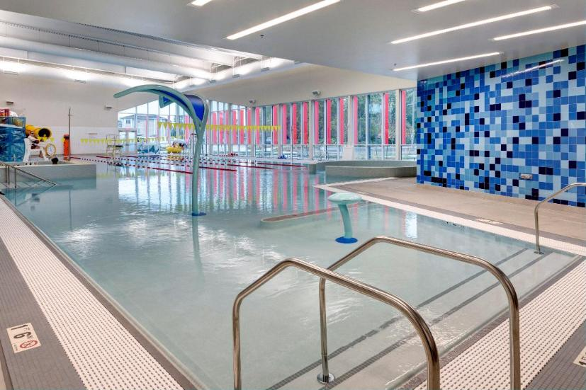
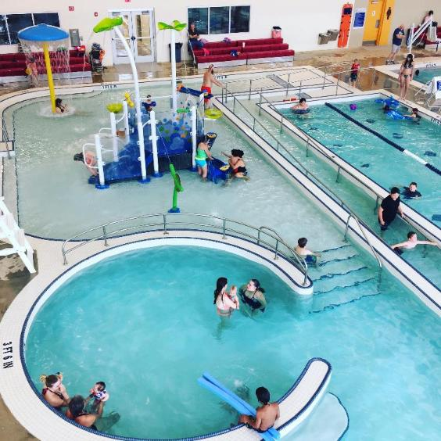
Children’s Area
Social Gather Area

Slide 11
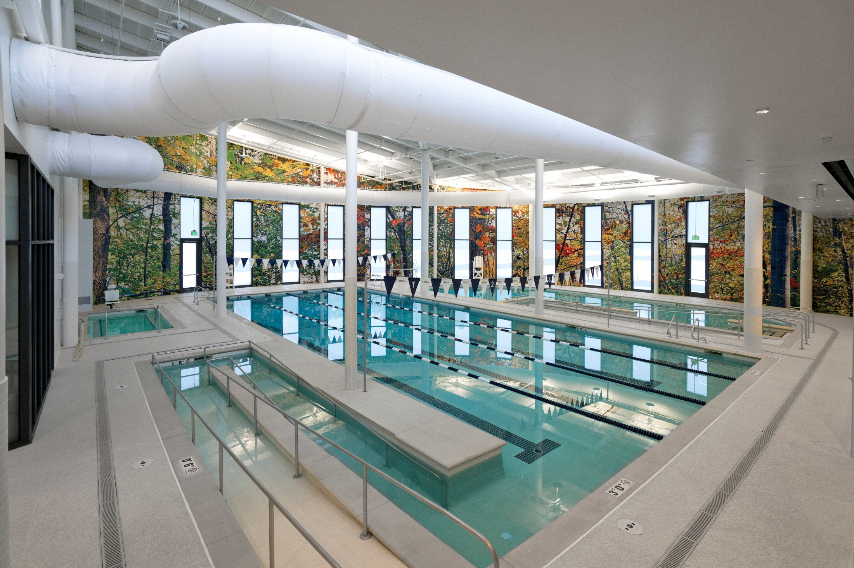
Accessibility features

Slide 12
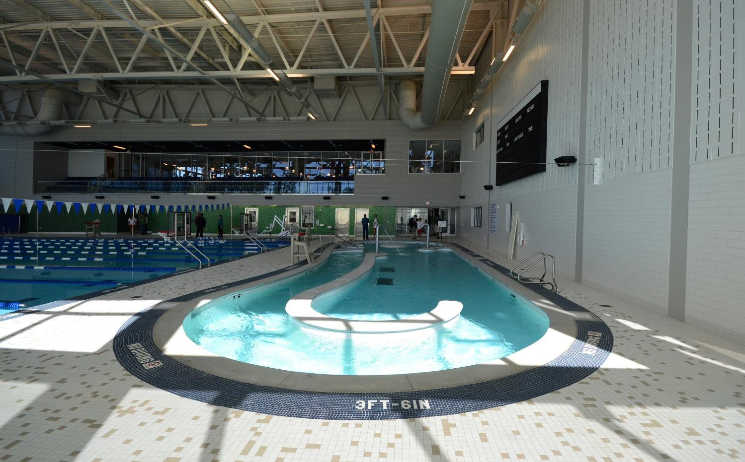
Current Channel

Slide 13
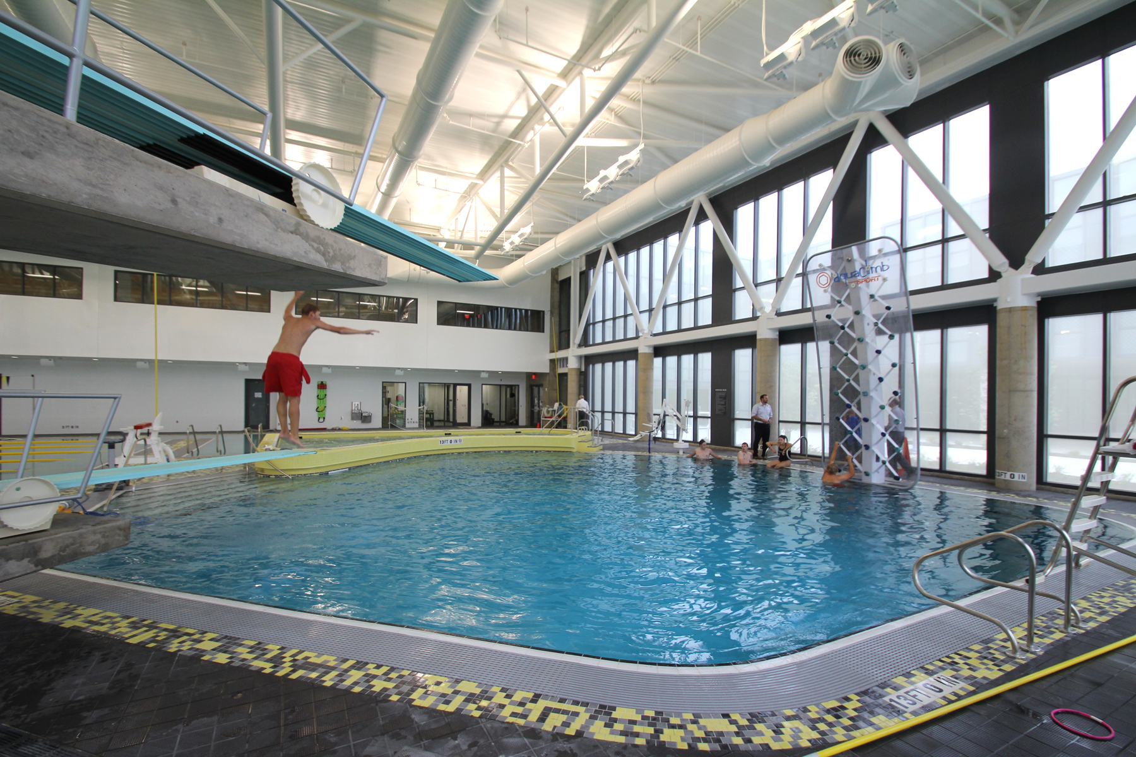
Deep Well Pool Feature

Slide 14
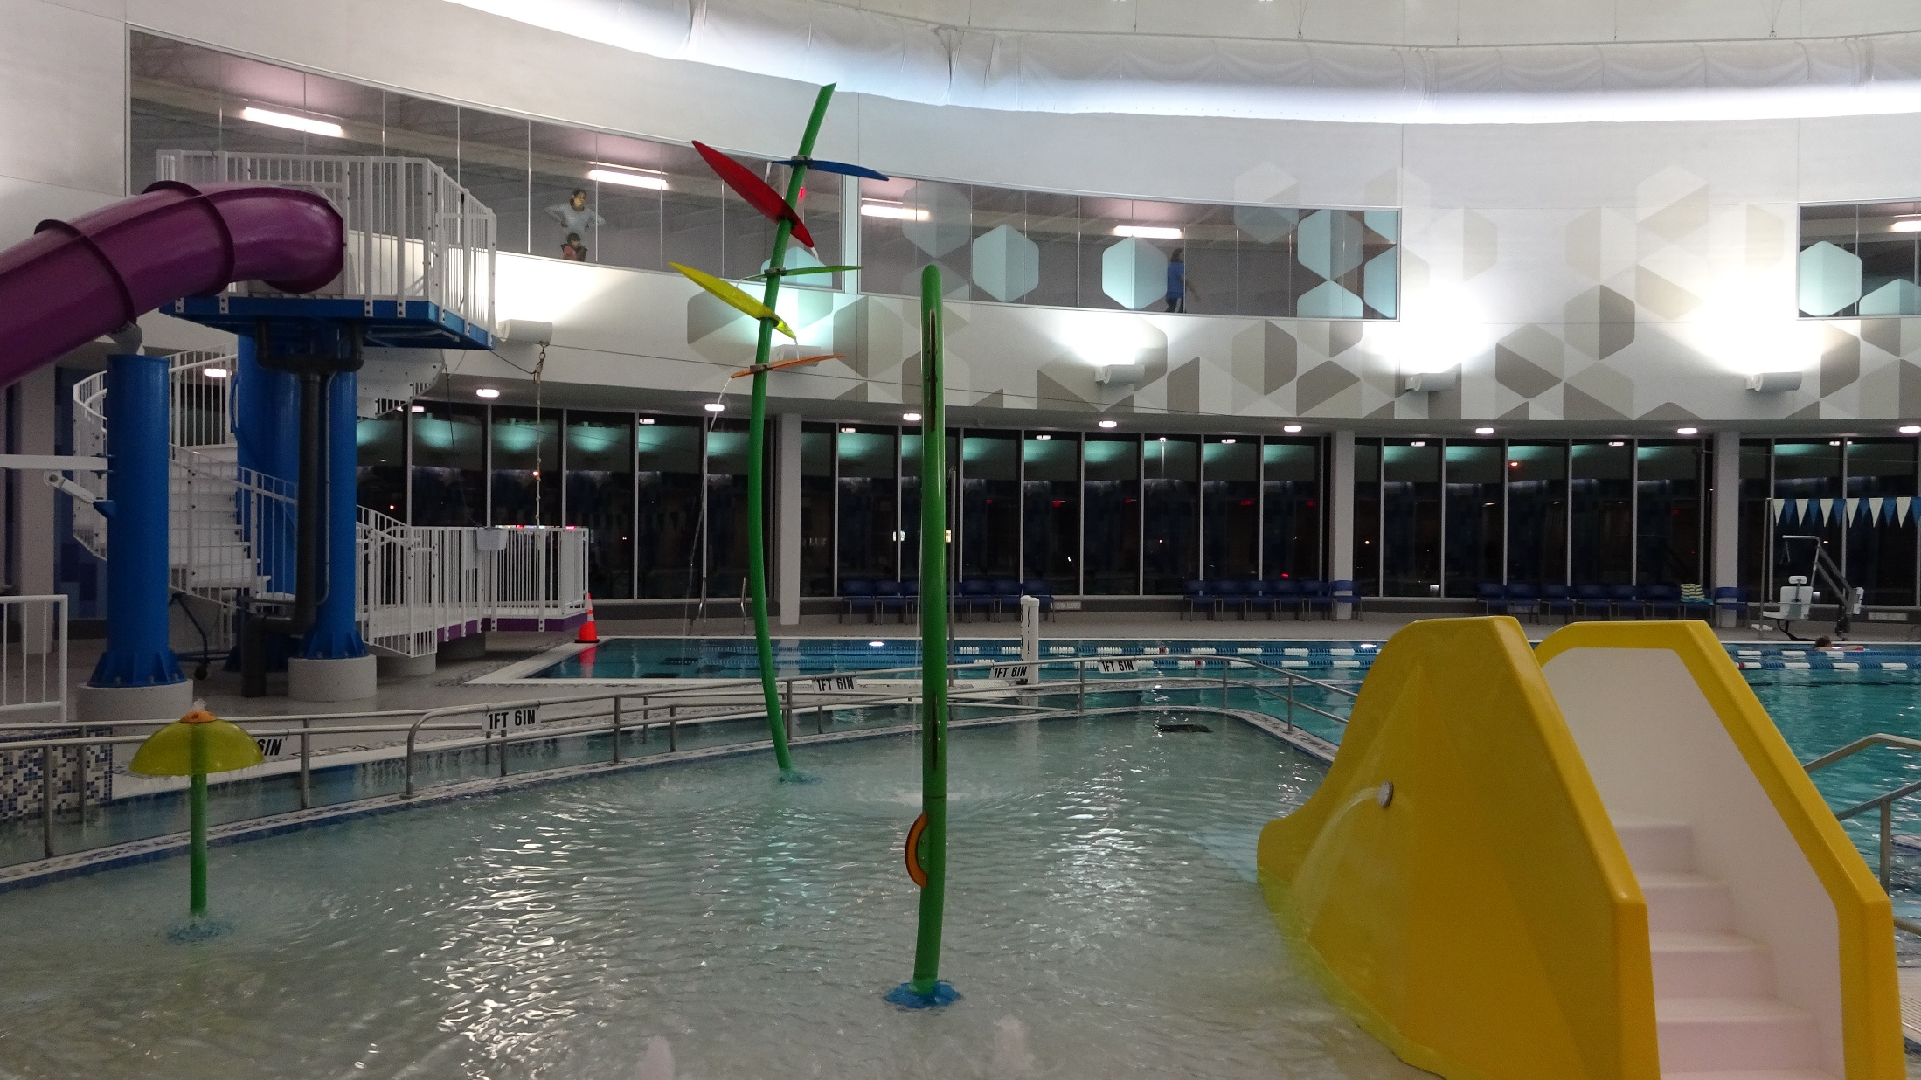
Children’s Area – Play Features

Slide 15
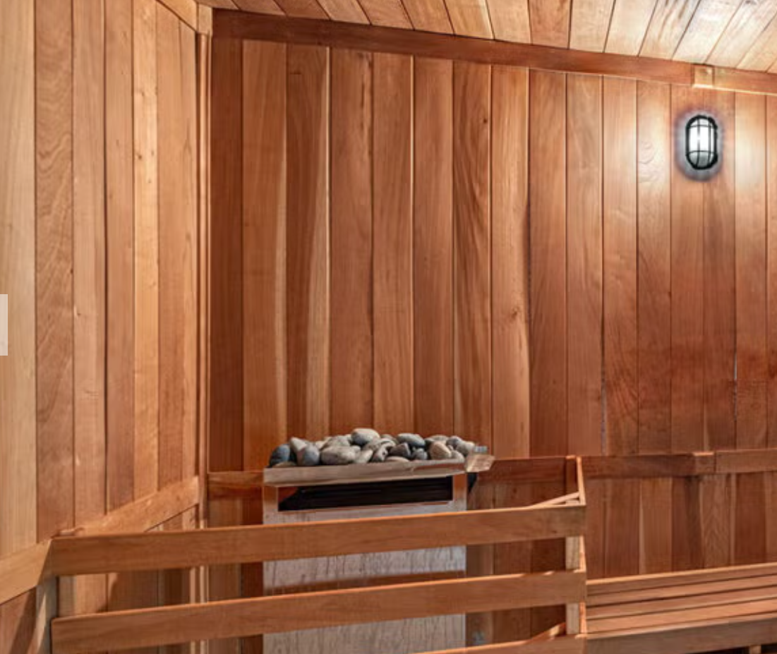
Sauna

Slide 16
Scenario A: Full Aquatics Renovation
Key Benefits
Preserves a strong aquatic identity for the community
Supports swim lessons, lap swimming, therapy, and family recreation
Familiar offering for residents and long‑time users
Potential to host regional programs or events
Maintains year‑round access to indoor water recreation
Key Considerations
Highest capital and ongoing operating costs
Increased maintenance, utilities, and staffing requirements
Greater dependence on specialized lifeguard staffing
Less flexibility to adapt to future recreation trends
Higher long‑term lifecycle costs compared to dry programming

Slide 17
SCENARIO B — REDUCED AQUATICS + DRY SPACE
(Balance between aquatics and flexible indoor recreation)
Includes:
Smaller or simplified aquatic component
Family or instructional pool elements retained
Reduced maintenance and water surface area compared to Scenario A
New dry, multi‑program spaces for:
  Fitness, wellness, and group classes
  Youth and teen activities
  Community programs and events
Optional indoor walking/jogging track extension
Flexible rooms that can adapt to changing recreation trends
Focus:
Provides aquatics while expanding year‑round, lower‑maintenance dry programming for broader age groups.

Slide 18
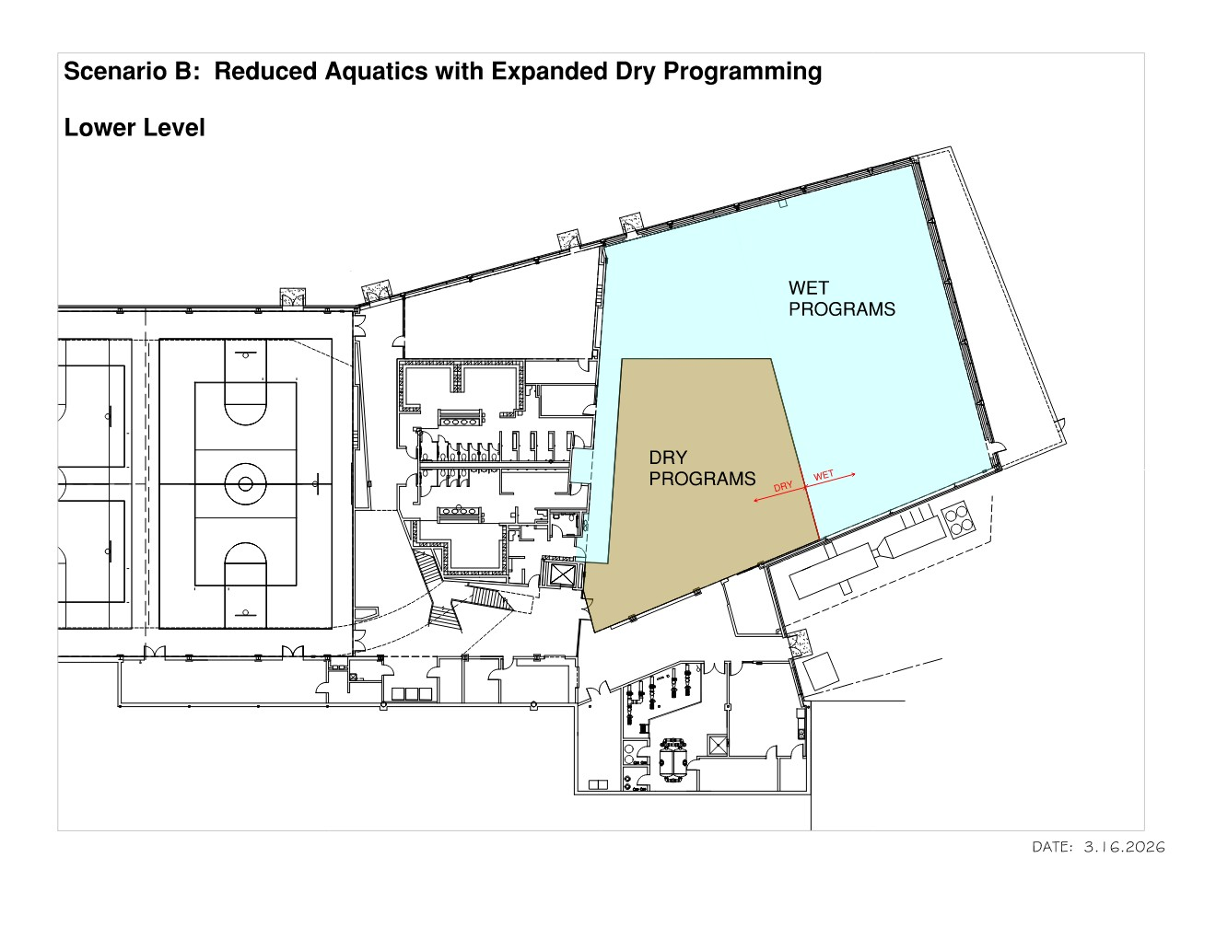

Slide 19
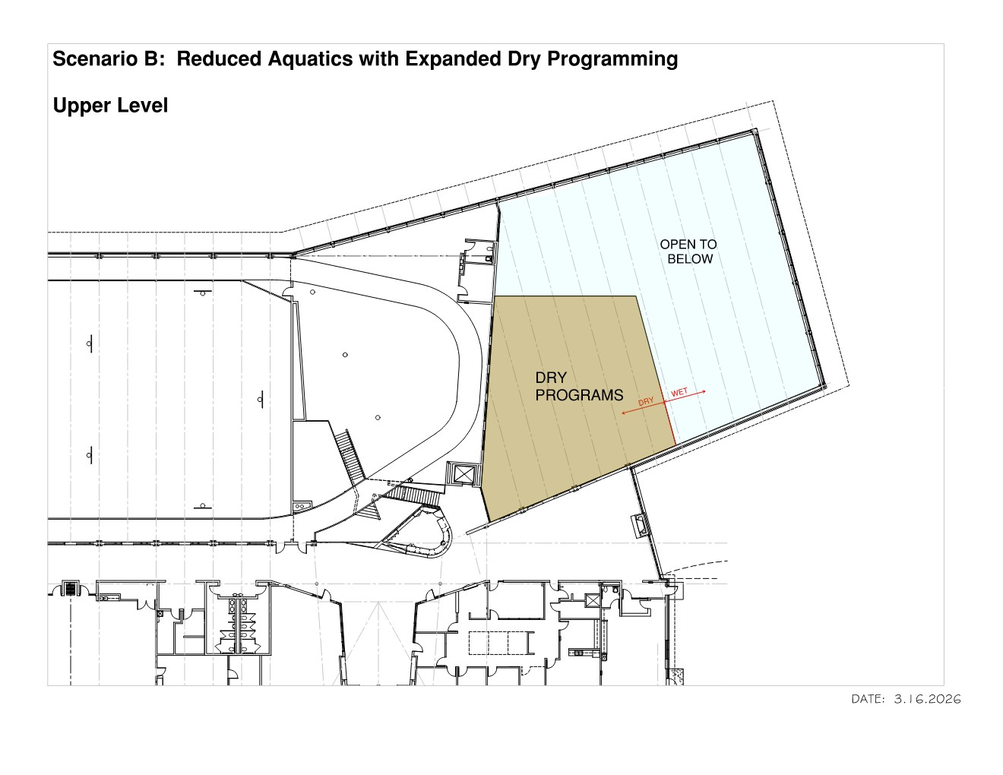

Slide 20
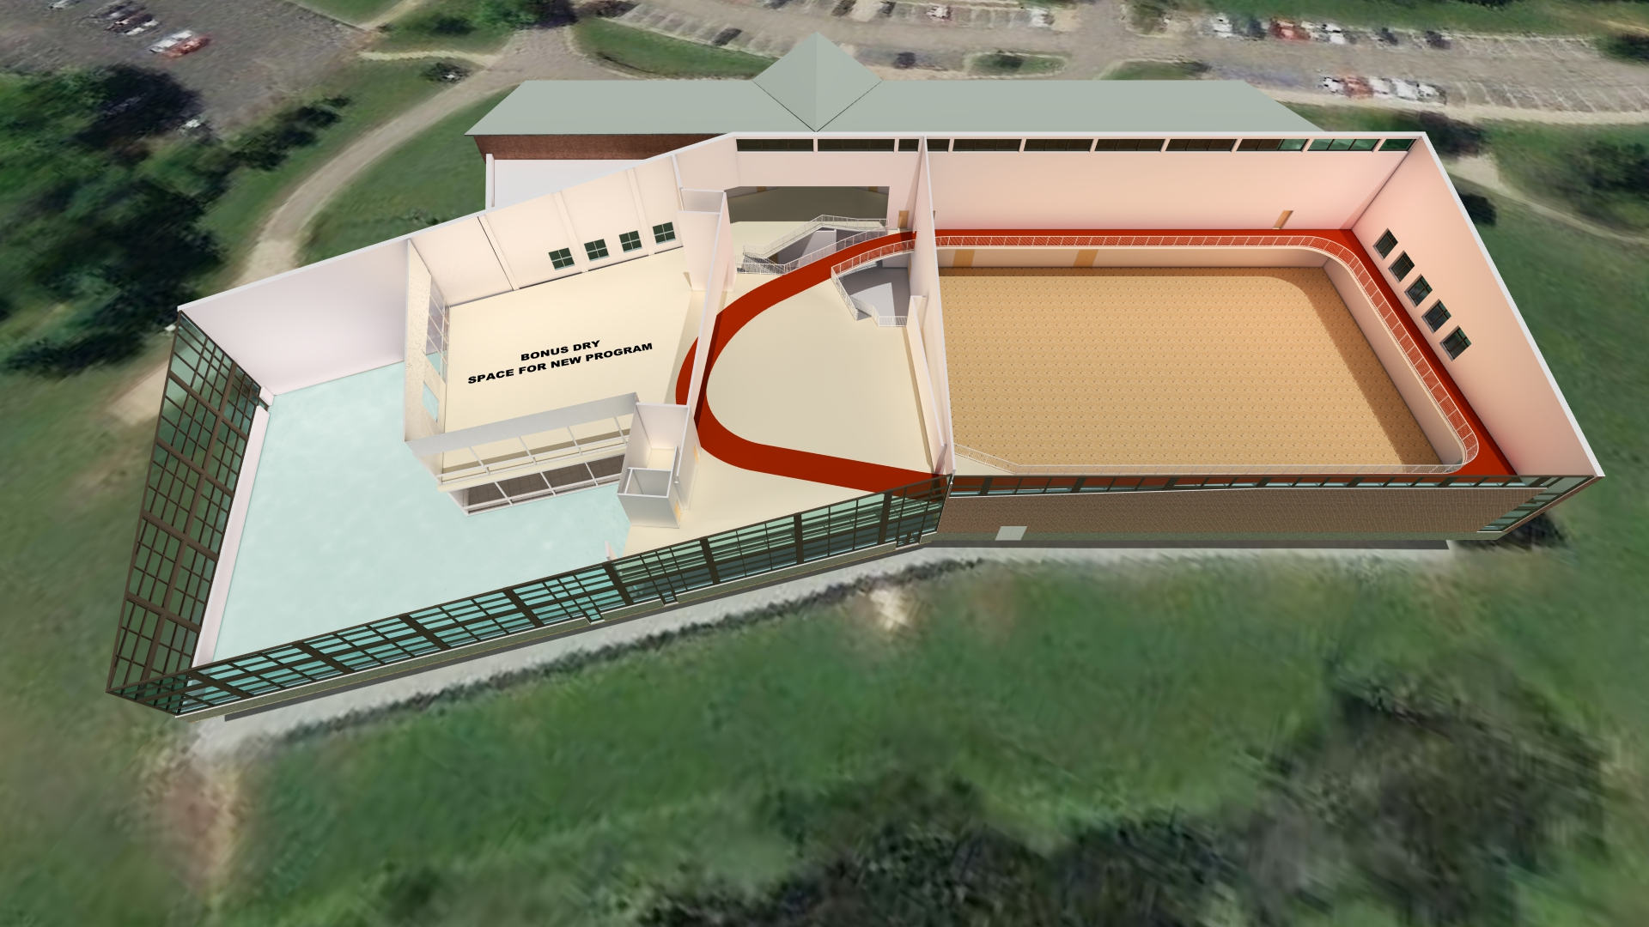

Slide 21
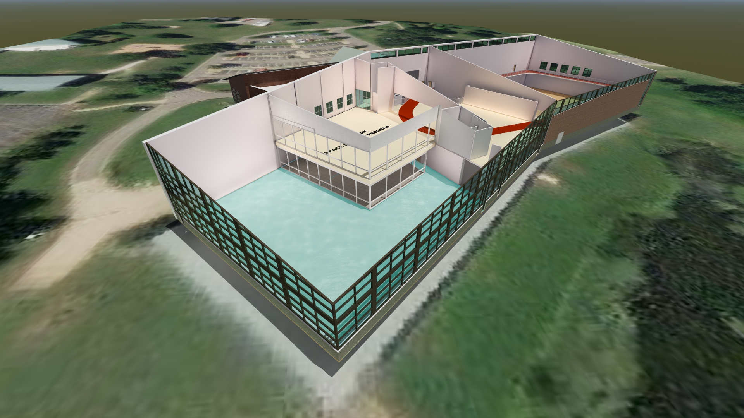

Slide 22
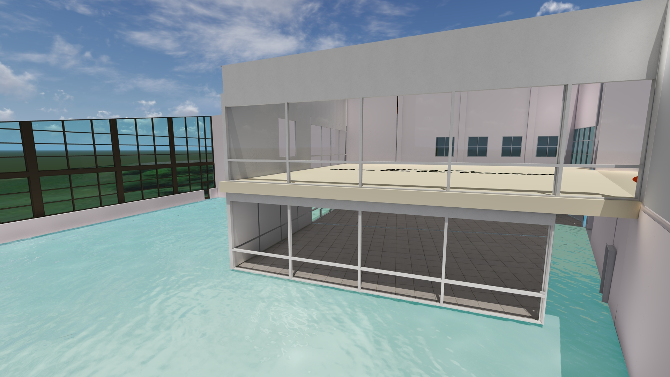

Slide 23
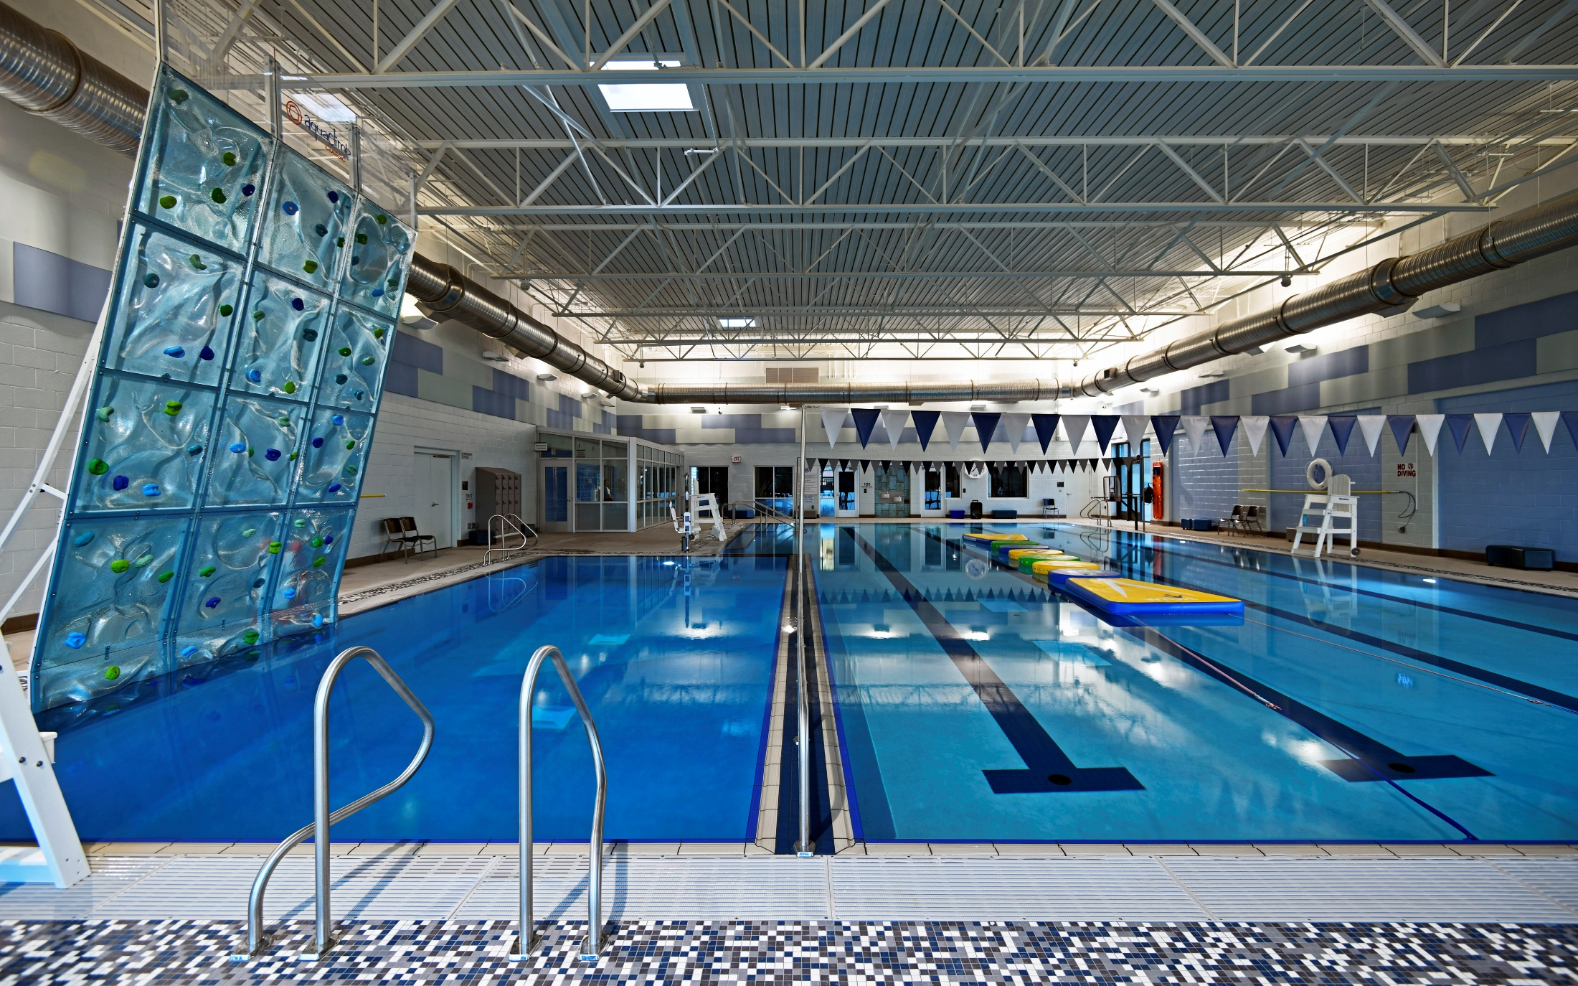
Comparable Reduced Indoor Aquatics (Precedent Examples)
Deep Water Zone

Slide 24
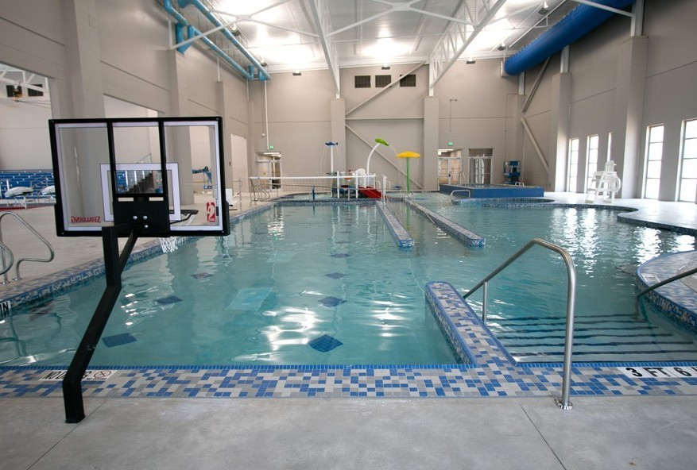
Multiple Areas for Multigenerational Utilization

Slide 25
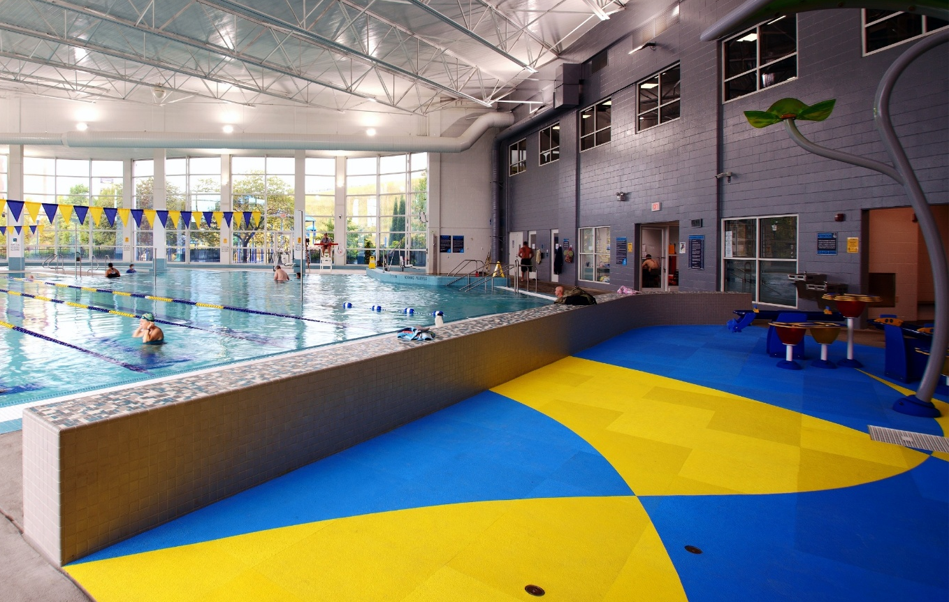
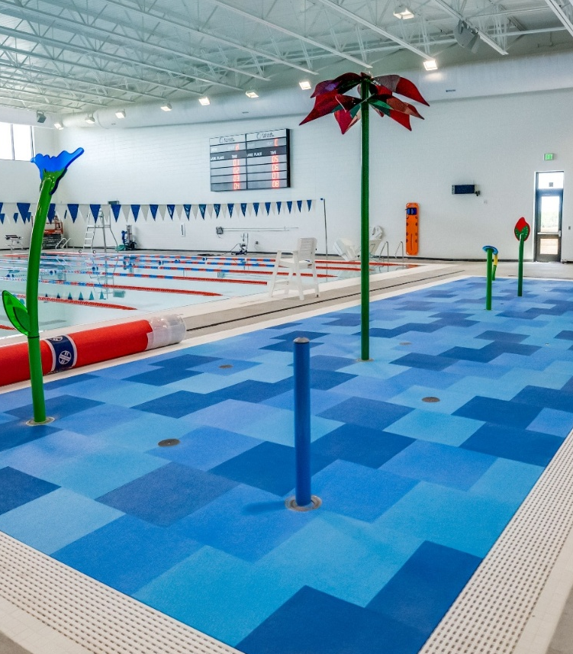
Youth & Teen Attraction Features (Examples)
Children’s Area – Spray Pad

Slide 26
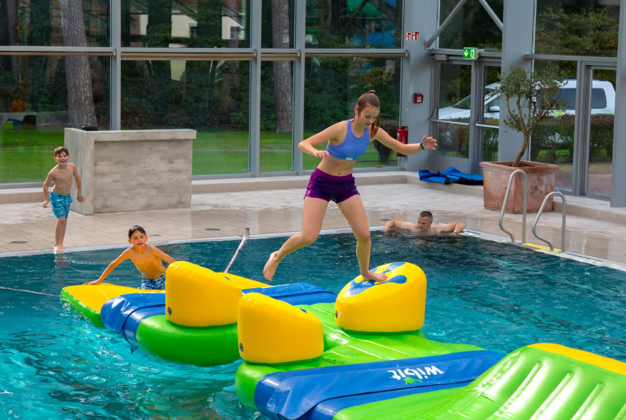
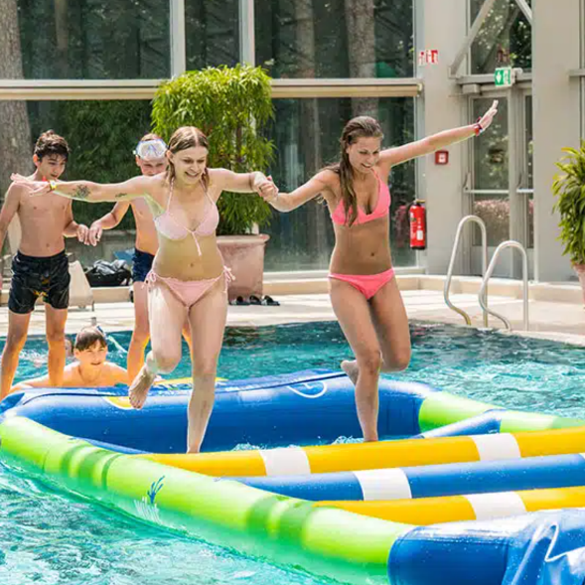
WIBIT
Inflatable Wibit Play Feature

Slide 27
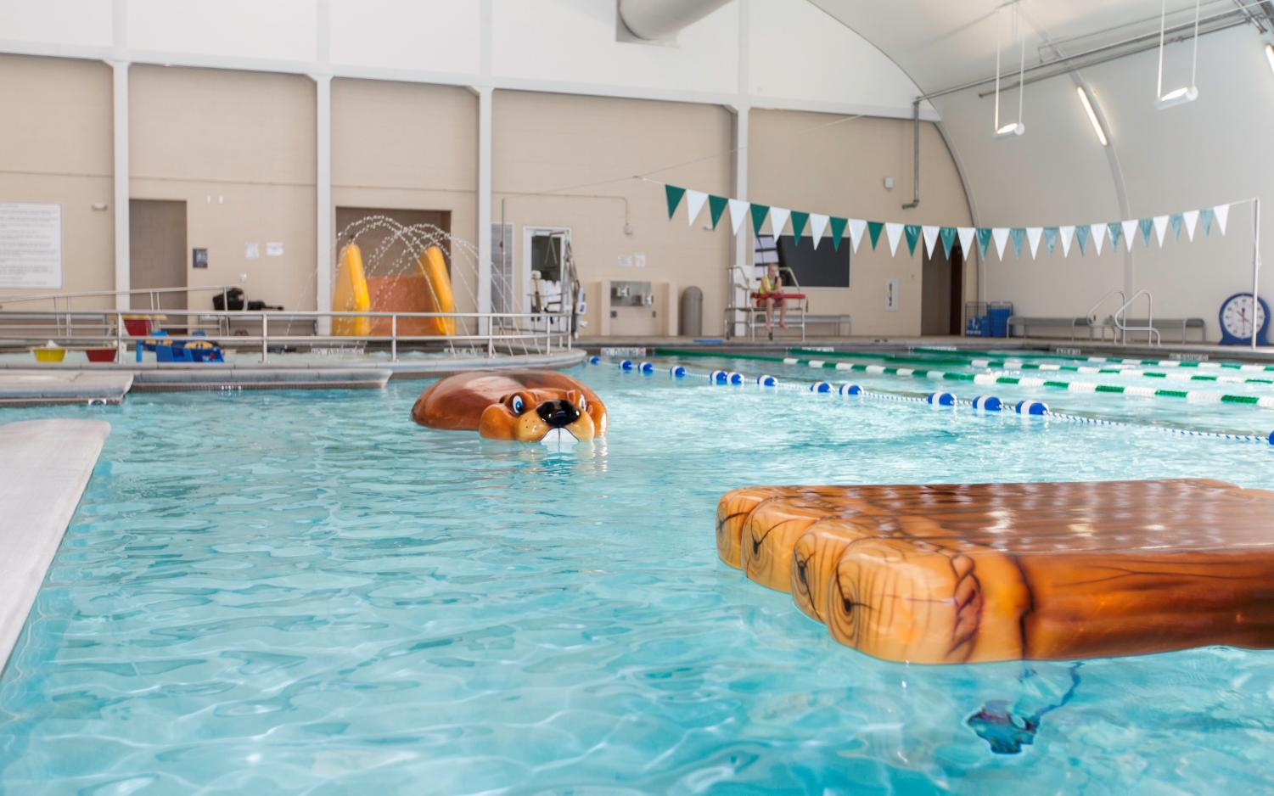
FLOATABLES
Floatable Play Features

Slide 28
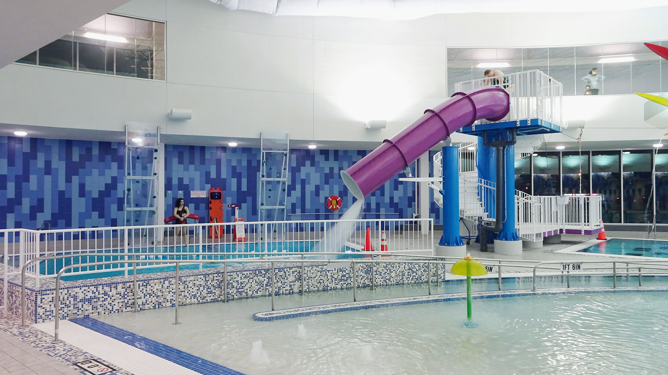
Drop Slide

Slide 29
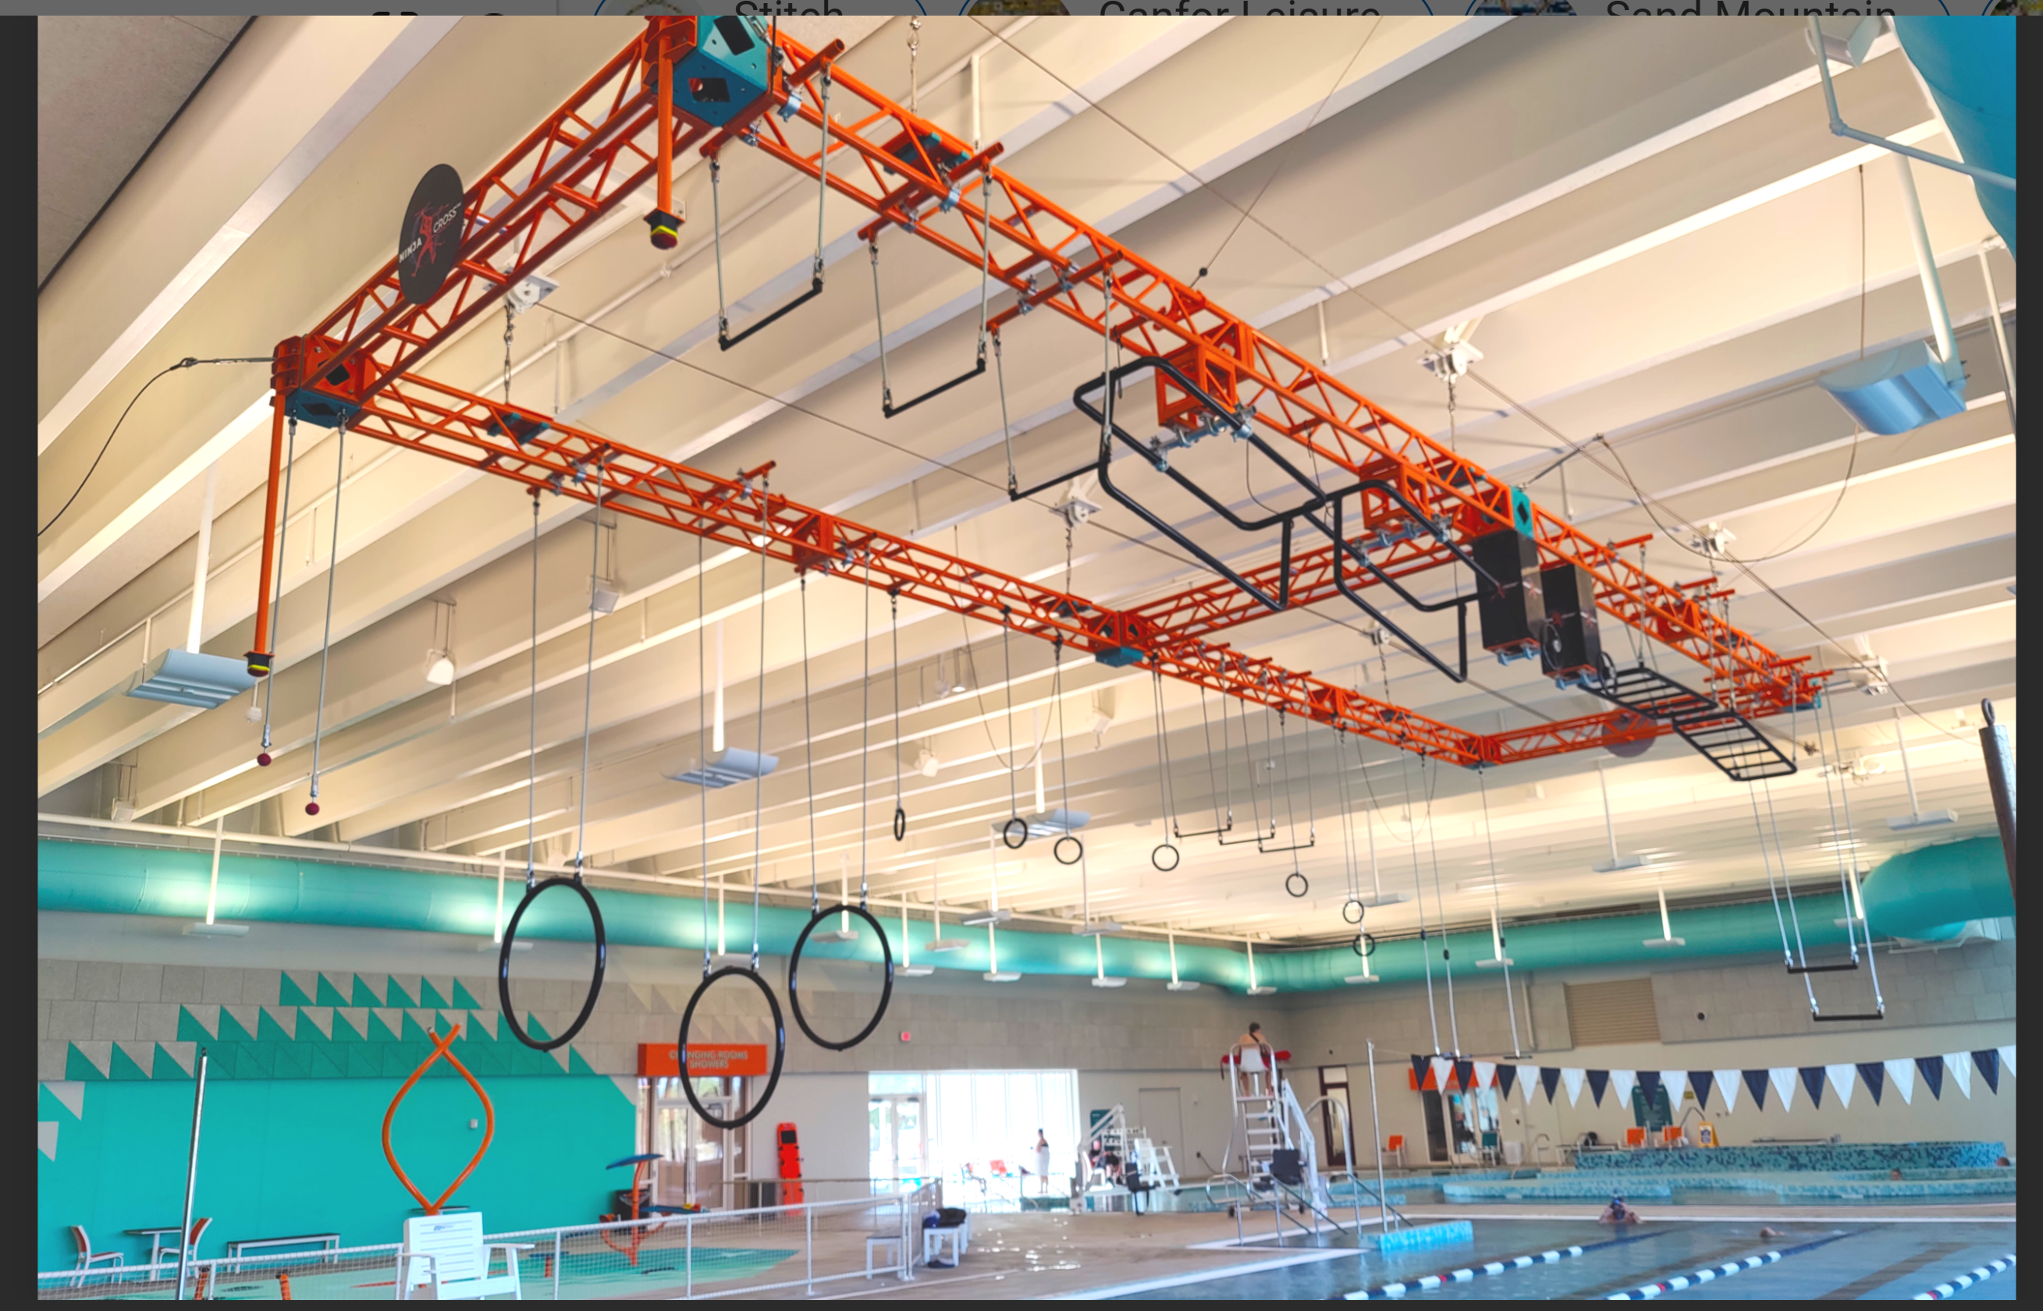
Drop-Down Ninja Cross Play Feature

Slide 30
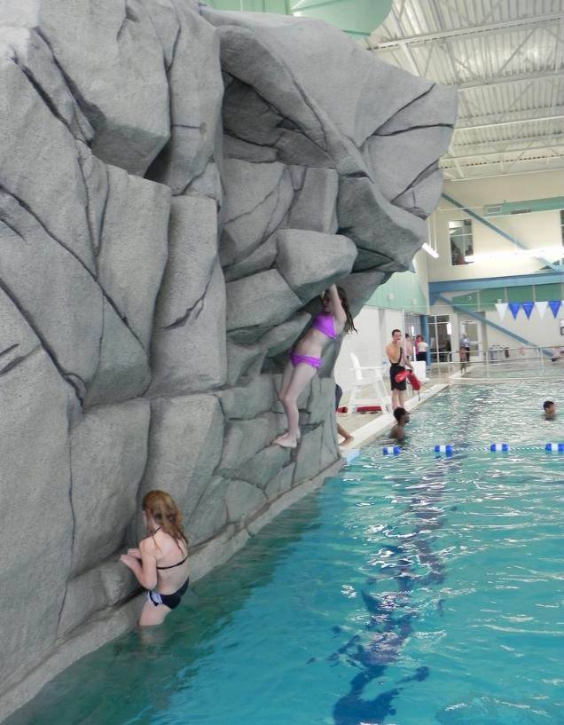
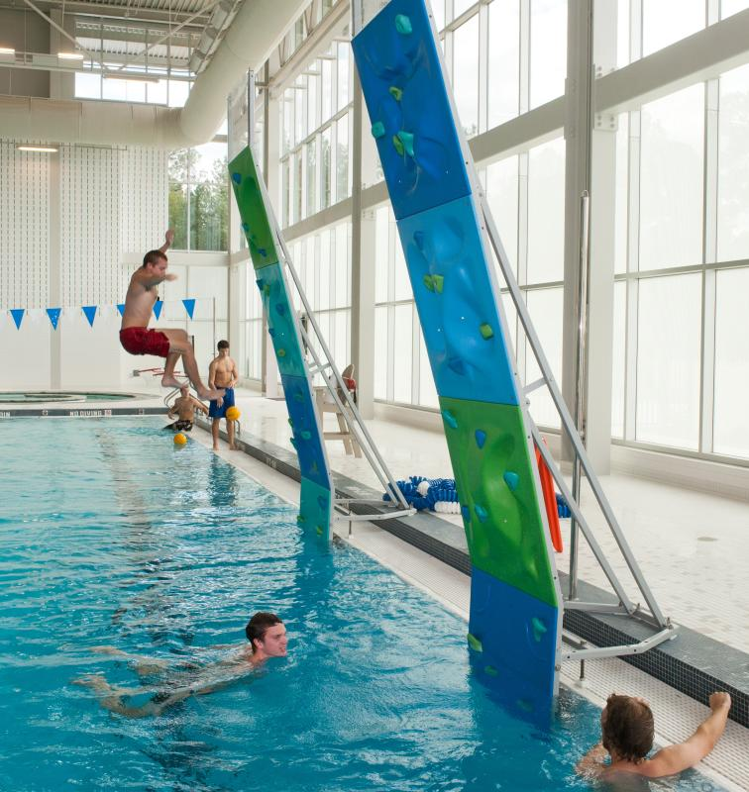
Climbing Structures

Slide 31
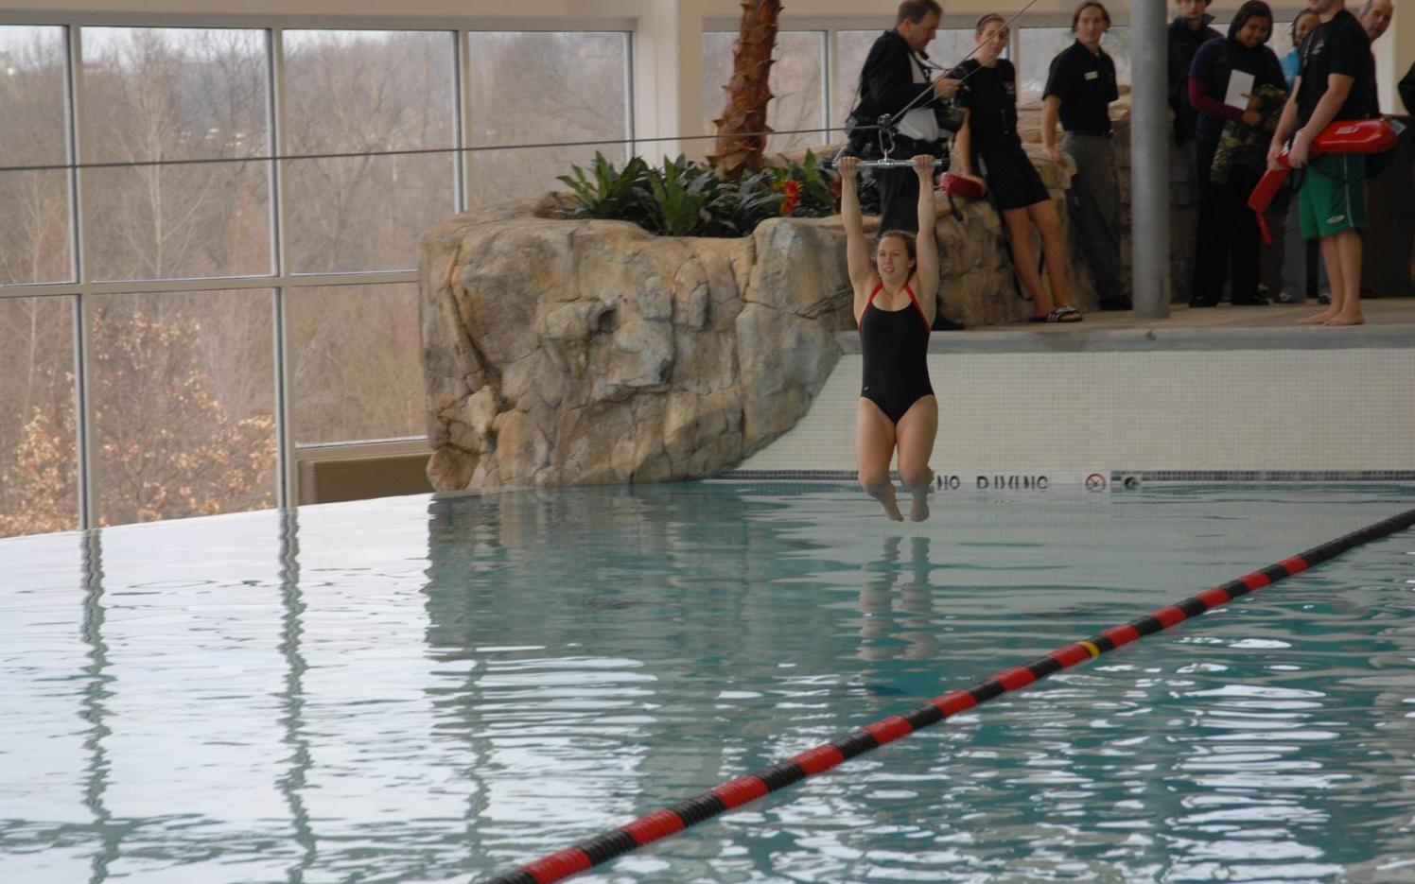
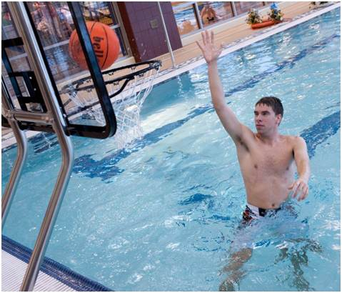
Zip Line – Thrill Feature

Slide 32
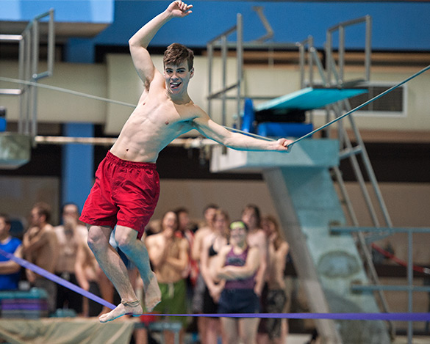
Slack-Line – Removable Feature

Slide 33
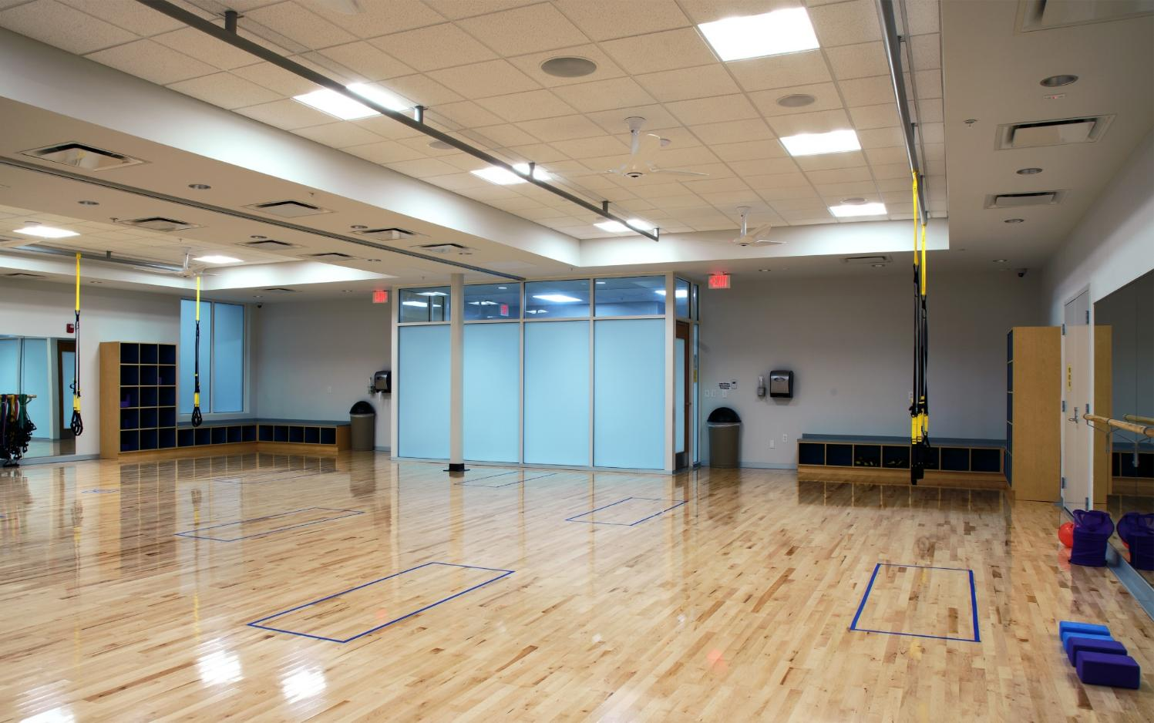
MULTI-PROGRAM SPACE
Multiuse Adaptable Program Space

Slide 34
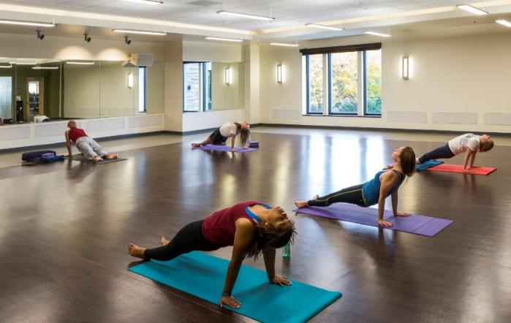
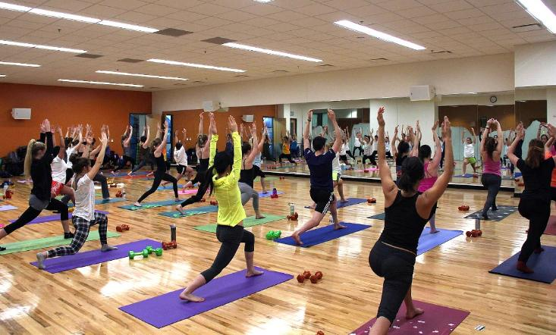
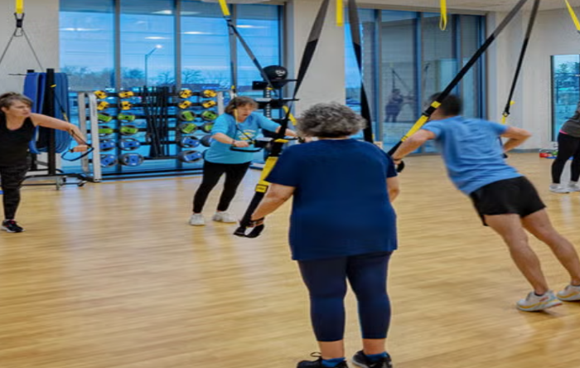
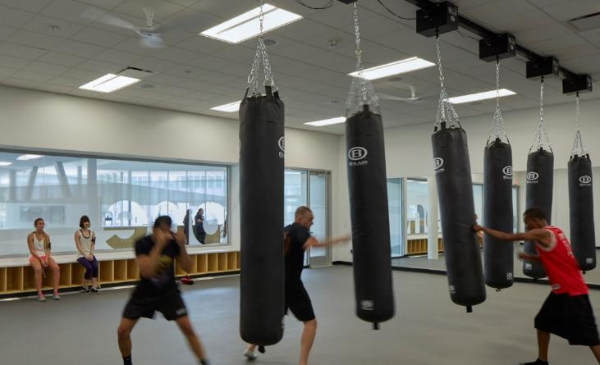
Multiuse Adaptable Program Space
Notes:
Natural light
Flexibility – as trends change so to have storage needs.
Where in the Building (proximetey to front door / how secluded.
12 ft. – 16 ft. Height
Wood Floors/Multipurpose Floors
Exterior Windows/Mirrors
Bag Storage
Equipment Storage
Mixed Size Rooms/Dividers
DIN Standards
Location in Building
Ceiling Fans
Flexibility

Slide 35
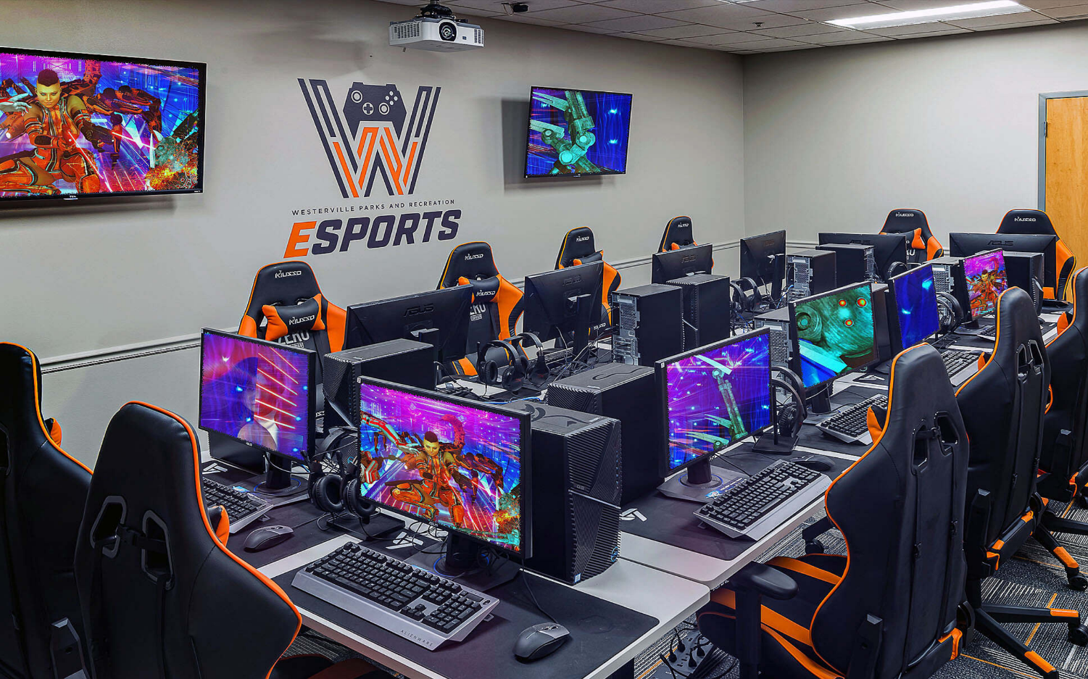
E - SPORTS
Emerging Recreation Option: E‑Sports & Technology-Based Programming

Slide 36
Scenario B: Reduced Aquatics + Expanded Dry Programming
Key Benefits
Retains aquatic opportunities while reducing overall complexity
Expands flexible, multi‑use dry spaces for broader age groups
Lower operating and maintenance costs than full aquatics
Supports year‑round programming with fewer seasonal impacts
Greater adaptability as community needs change
Balances traditional recreation with emerging trends
Key Considerations
Reduced aquatic offerings may not meet all user expectations
Requires careful programming balance between wet and dry uses
Some aquatic programs may need to be modified or limited
Still involves ongoing pool maintenance and staffing

Slide 37
SCENARIO C — ALL DRY / NO AQUATICS
(Full conversion to non‑aquatic indoor recreation)
Includes:
Removal of all indoor aquatic facilities
Conversion to fully dry, flexible recreation space
Potential program elements such as:
  Multi‑use activity courts
  Fitness and wellness spaces
  Walking/jogging track
  Climbing or adventure‑based recreation
  Youth, teen, and adult programming areas
  Community event and multipurpose rooms
Lower long‑term maintenance and operational complexity
Focus:
Maximizes flexibility, reduces operating costs, and supports diverse non‑aquatic programming.

Slide 38
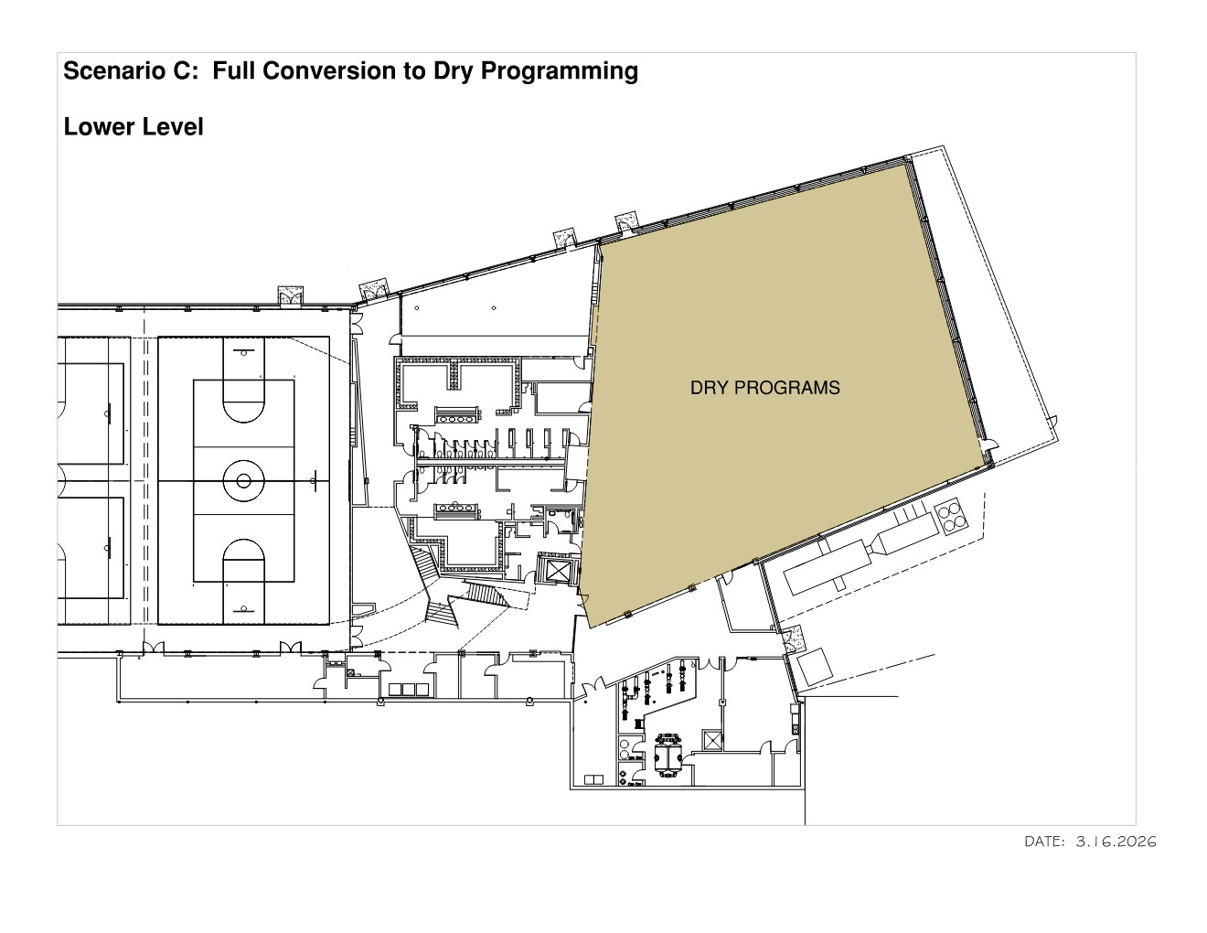

Slide 39
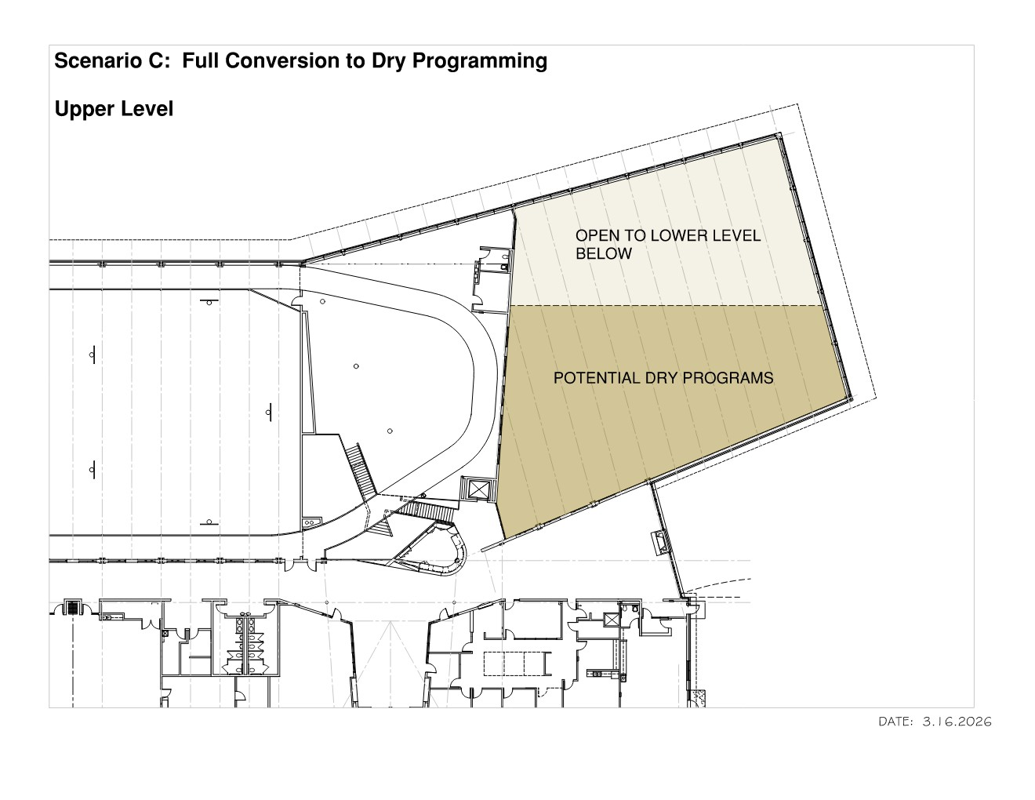

Slide 40
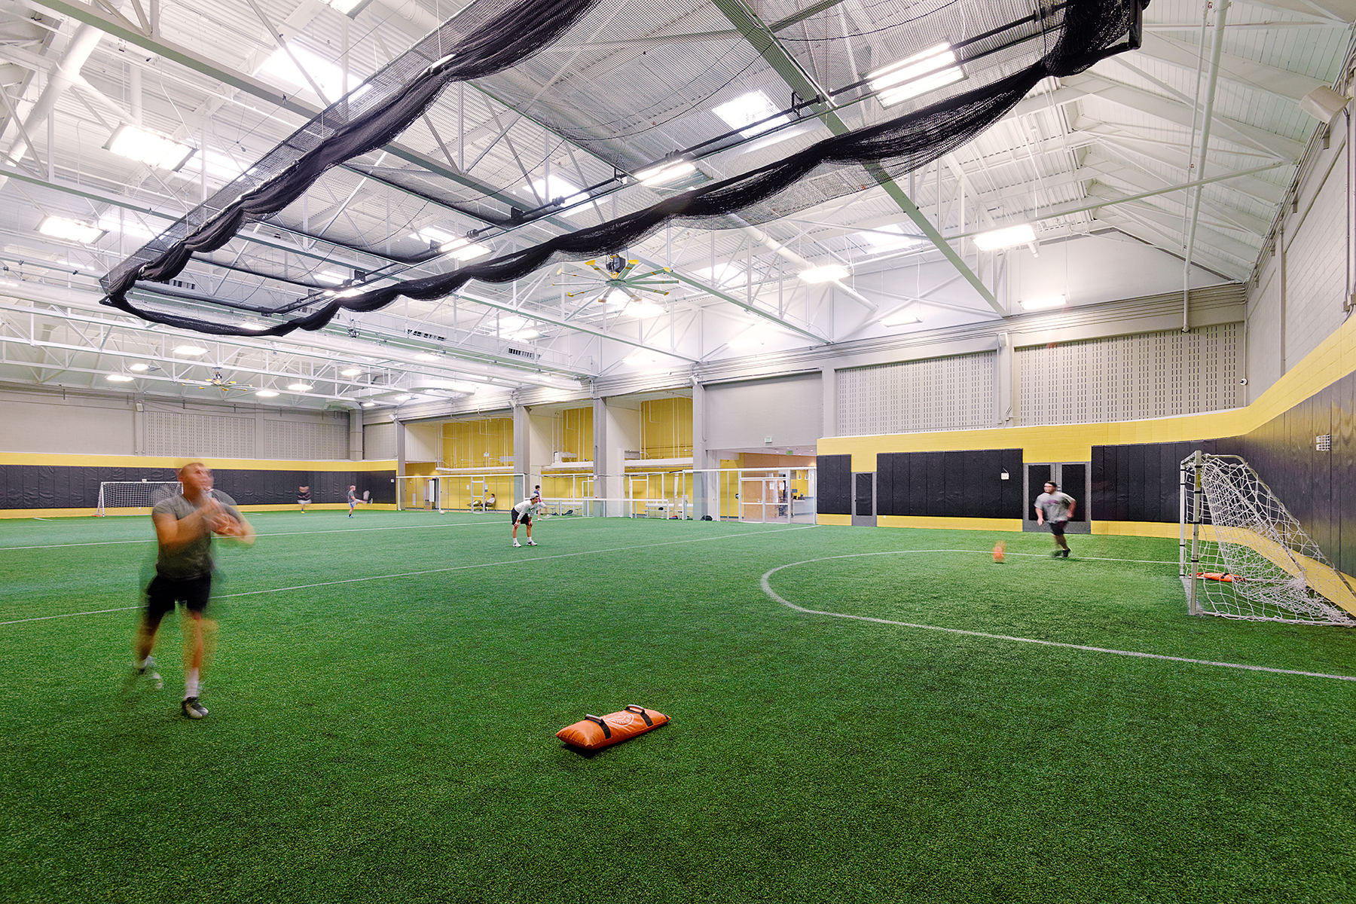
Comparable Expanded Dry Programming Features (Precedent Examples)
Multipurpose Indoor Turf Area

Slide 41
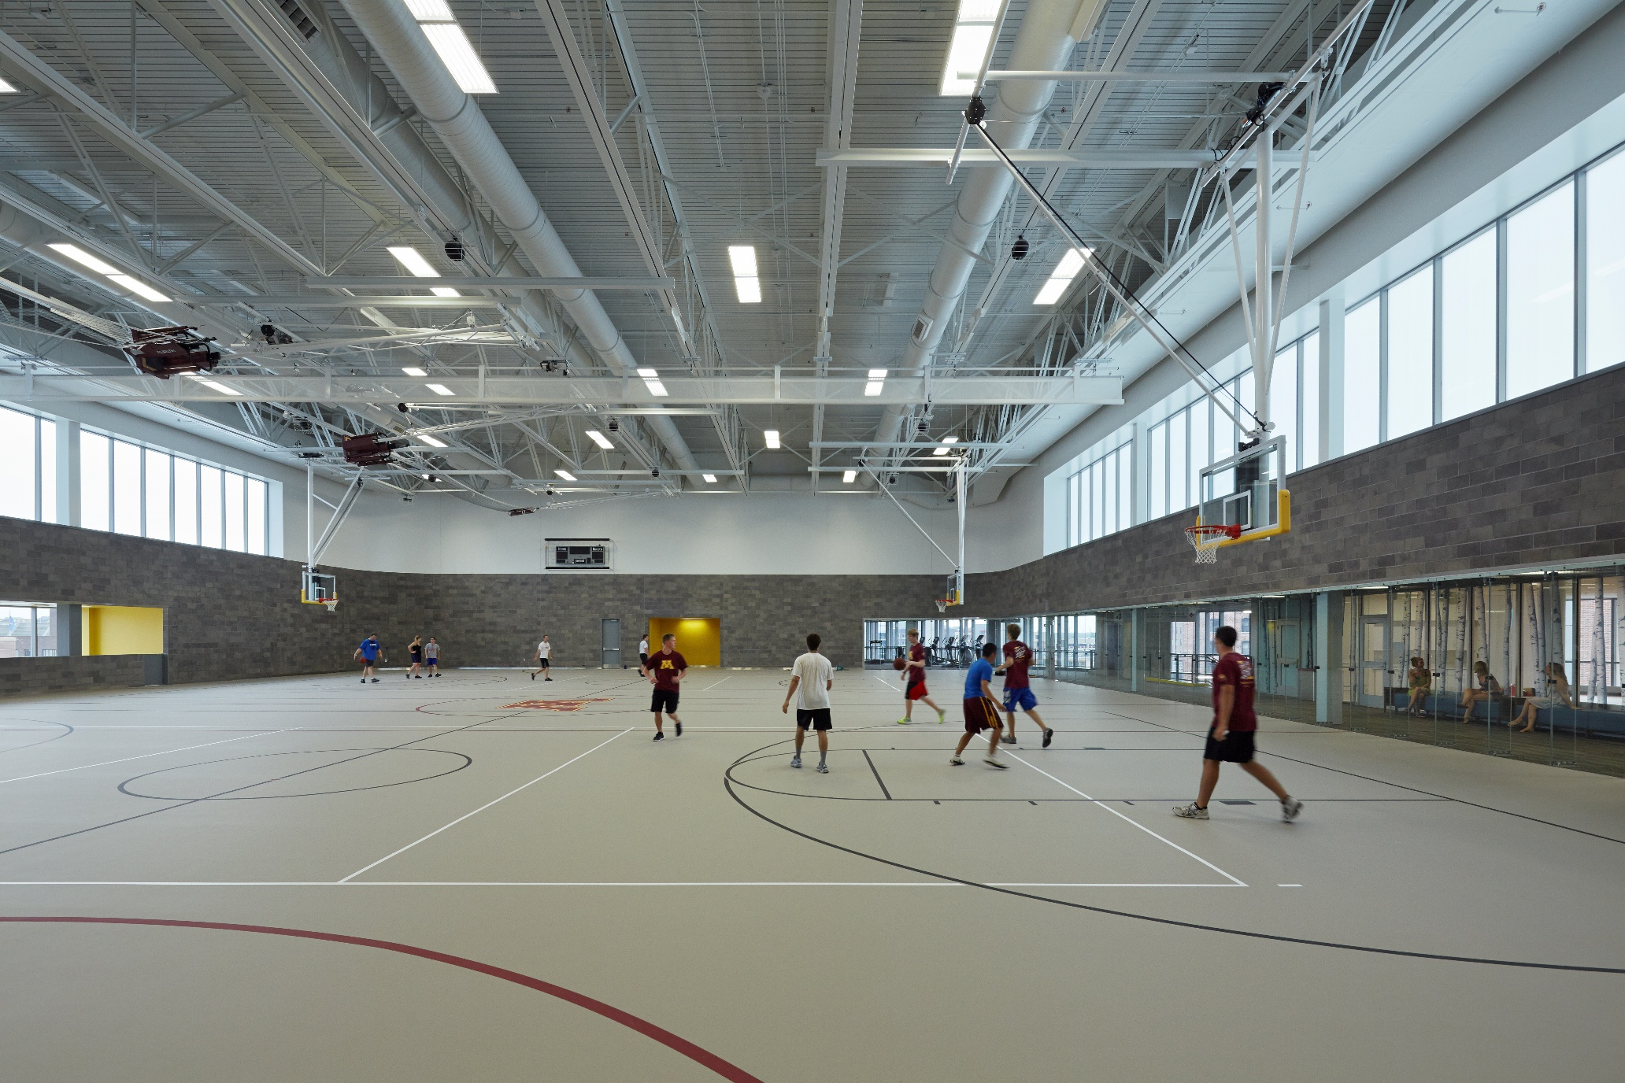

Slide 42
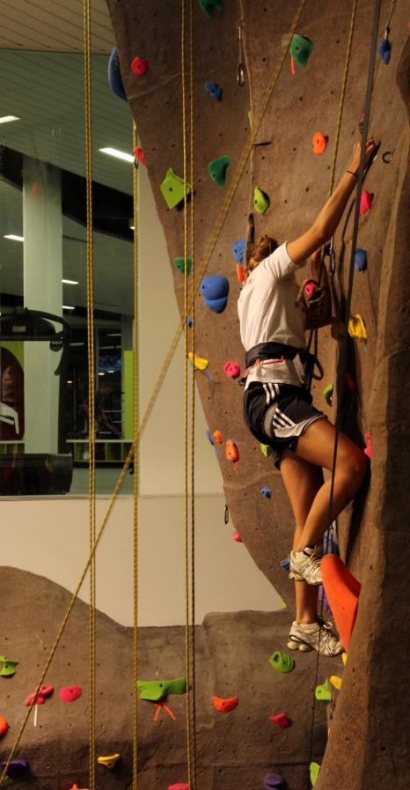
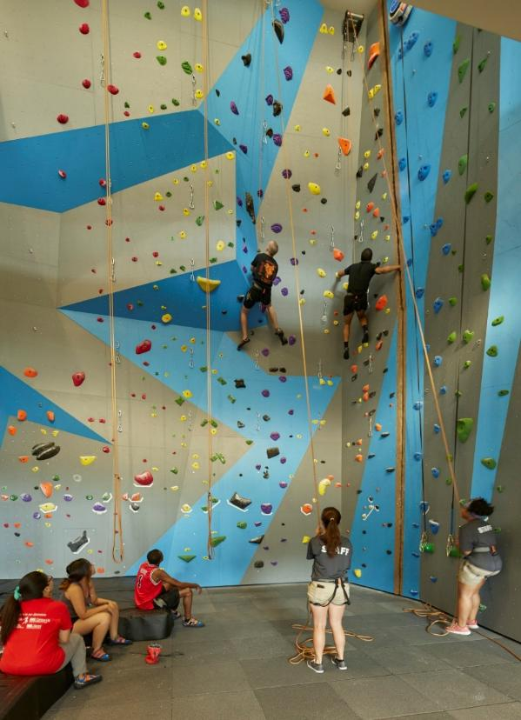
Indoor Climbing Wall: Active Recreation Option

Slide 43
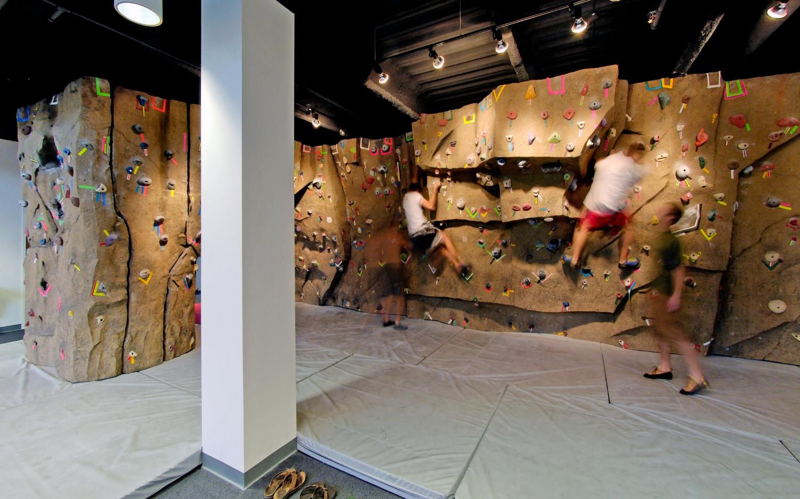
Indoor Bouldering Wall: Low Height Climbing Feature

Slide 44
Scenario C: All Dry / No Aquatics
Key Benefits
Lowest long‑term operating and maintenance costs
Maximum flexibility for evolving recreation and community uses
Simplified staffing and facility operations
Supports a wide range of programs: fitness, youth, teens, adults, and seniors
Spaces can be easily reconfigured over time
Reduces risk associated with aging aquatic infrastructure
Key Considerations
Eliminates indoor aquatic programming entirely
Loss of swim lessons, water therapy, and family aquatics
May require alternative arrangements for aquatic needs
Potential public concern from users who value indoor pools
Represents a significant shift from historical use of the facility

Slide 45
Aquatics vs. Dry Programming – Key Tradeoffs”
Topic | Aquatics | Dry Space
Capital cost | Higher | Lower
Ongoing maintenance | Higher | Lower
Staffing | Specialized | Flexible
Age appeal | Families | Broader demographics
Revenue predictability | Seasonal | More consistent

Slide 46
Next Steps: Community Input
We invite the community to join us and share your thoughts at our first Community Input Meeting:
Monday, March 30 | 4:00–7:00 PM at The Centre
(Drop‑in, open‑house format)
A second Community Input Meeting is planned for:
Tuesday, April 14
Location to be determined

